Slide 1
Mechanisms and Robotics Laboratory Exercises - Day 2

Slide 2
Contents
Exercises Day - 1
Mapping-1: Rotation of a frame
Mapping - 2: Multiple Rotations of a frame
Homogenous Transformation
Forward kinematics-1: 2 DOF Planar manipulator
Notes:
References:
https://opentextbc.ca/teachinginadigitalage/chapter/section-8-1-a-short-history-of-educational-technology/?utm_source=timminstoday.com&utm_campaign=timminstoday.com&utm_medium=referral
https://www.riemysore.ac.in/ict/unit__7__elearning.html#7.5
https://www.youtube.com/watch?v=jTH3ob1IRFo
Skinner, B. (1968) The Technology of Teaching, 1968. New York: Appleton-Century-Crofts

Slide 3
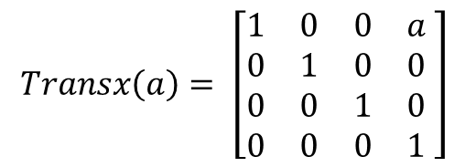
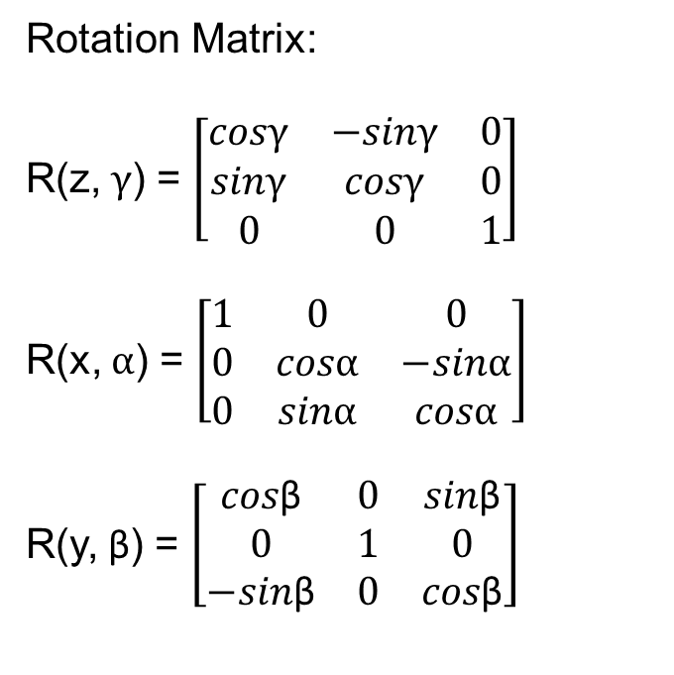
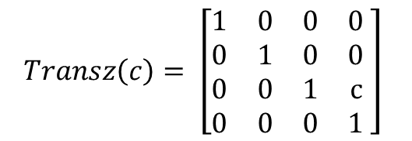
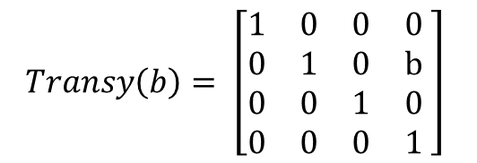
Solution
Rotation Matrix:
R(z, $γ$) = $\left[\begin{matrix}cosγ & −sinγ & 0 \\ sinγ & cosγ & 0 \\ 0 & 0 & 1\end{matrix}\right]$
R(x, $α$) = $\left[\begin{matrix}1 & 0 & 0 \\ 0 & cosα & −sinα \\ 0 & sinα & cosα\end{matrix}\right]$
R(y, β) = $\left[\begin{matrix}cos\text{β} & 0 & sin\text{β} \\ 0 & 1 & 0 \\ −sin\text{β} & 0 & cos\text{β}\end{matrix}\right]$
$$Transx\left(a\right)= \left[\begin{matrix}1 & 0 & 0 & a \\ 0 & 1 & 0 & 0 \\ 0 & 0 & 1 & 0 \\ 0 & 0 & 0 & 1\end{matrix} \right]$$
$$Transy\left(b\right)= \left[\begin{matrix}1 & 0 & 0 & 0 \\ 0 & 1 & 0 & b \\ 0 & 0 & 1 & 0 \\ 0 & 0 & 0 & 1\end{matrix} \right]$$
$$Transz\left(c\right)= \left[\begin{matrix}1 & 0 & 0 & 0 \\ 0 & 1 & 0 & 0 \\ 0 & 0 & 1 & c \\ 0 & 0 & 0 & 1\end{matrix} \right]$$

Slide 4
Homogeneous Transformation

Slide 5
Problem No. 3
Frame {2} is rotated w.r.t frame {1} about x- axis by an angle of 60º followed by a translation of [7 5 7]^{T.} Obtain the transformation matrix T. Also find the description of the point w.r.t [2 4 6]^{T}

Slide 6
Solution
transx(a)*transy(b)*transz(c)*rotx(60)*[2,4,6,1]’

Slide 7
Forward kinematics-1: 2 DOF Planar manipulator

Slide 8
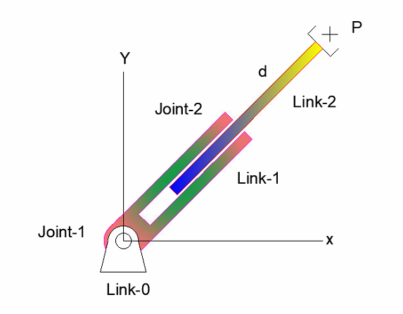
Problem No. 4
Obtain the position and orientation of the tool point P with respect to the base for the 2 DOF, RP planar manipulator shown in figure. Consider joint angle 120 degrees and link (L1) length 150 mm and extension 100mm.

Slide 9
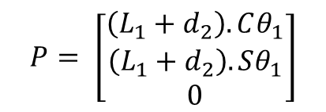
Solution:
[x’,y’,z’] = Rotz (θ1)*Transx(L1)*Rotz(90)* Rotx(90)* Transz(d1)* [0,0,0]’
Link i | θ | d | α | a | Home
1 | θ1 |  | 90 | L1 | 90
2 |  | d1
$$P= \left[\begin{matrix}\left(L_{1}+d_{2}\right).Cθ_{1} \\ \left(L_{1}+d_{2}\right).Sθ_{1} \\ 0\end{matrix}\right]$$

Slide 10
Forward kinematics-1: 3 dof Cylindrical manipulator

Slide 11
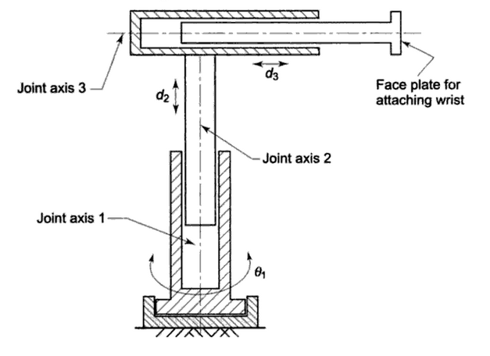
Cylindrical arm
Problem No. 5
L1 = 700 mm
L2 = 600 mm
d2 = 100 mm
d3 = 200 mm

Slide 12
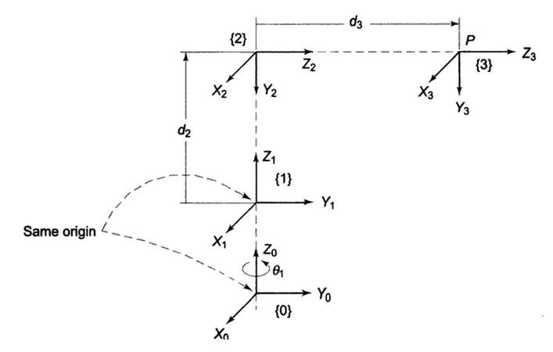
Cylindrical arm
Problem No. 5

Slide 13
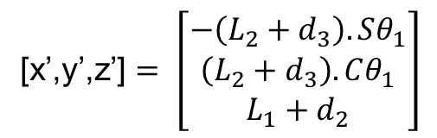
Solution:
Solution: [x’,y’,z’] = [Rotz(θ1).Transz(L1)].[Transz(d2).Rotx(-90).transz(L2)].Transz(d3).[0,0,0]’
Link i | θ | d | α | a | Home
1 | θ1 | L1
2 |  | d2, L2 | -90
3 |  | d3
[x’,y’,z’] $= \left[\begin{matrix}−\left(L_{2}+d_{3}\right).Sθ_{1} \\ \left(L_{2}+d_{3}\right).Cθ_{1} \\ L_{1}+d_{2}\end{matrix}\right]$

Slide 14
Forward kinematics-1: 3 dof Articulated Manipulator

Slide 15
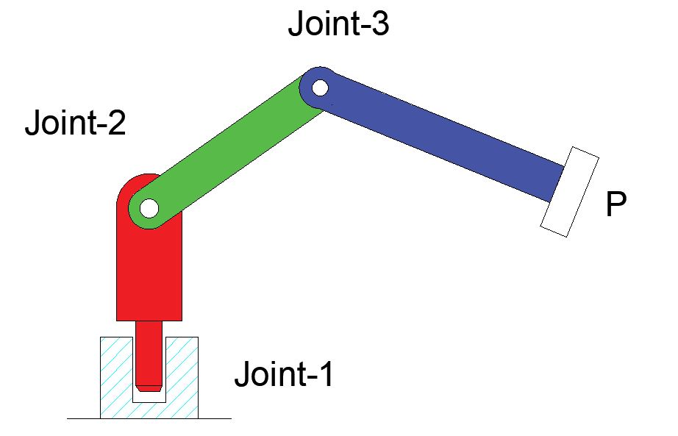
3 dof Articulated manipulator
Problem No. 6
Develop workspace points in MATLAB for articulated manipulator whose joint angles are π, π/2 and π/2, link lengths L1 = 100mm, L₂=L₃=300 mm.

Slide 16
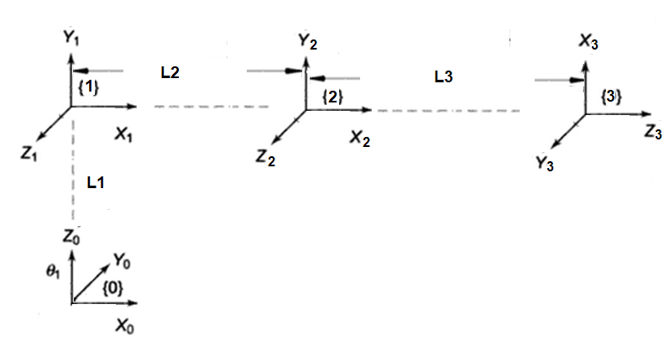
Link i | θ | d | α | a | Home
1 | θ1 | L1 | 90
2 | θ2 |  |  | L2
3 | θ3 |  | 90 | L3 | 90

Slide 17
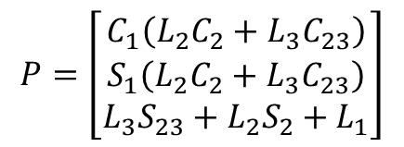
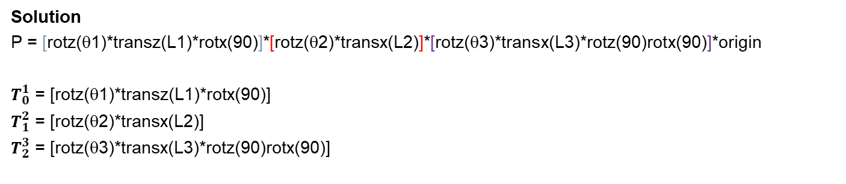
Solution
P = [rotz(θ1)*transz(L1)*rotx(90)]*[rotz(θ2)*transx(L2)]*[rotz(θ3)*transx(L3)*rotz(90)rotx(90)]*origin
$T_{0}^{1}$ = [rotz(θ1)*transz(L1)*rotx(90)]
$T_{1}^{2}$ = [rotz(θ2)*transx(L2)]
$T_{2}^{3}$ = [rotz(θ3)*transx(L3)*rotz(90)rotx(90)]
Link i | θ | d | α | a | Home
1 | θ1 | L1 | 90
2 | θ2 |  |  | L2
3 | θ3 |  | 90 | L3 | 90
$$P=\left[\begin{matrix}C_{1}\left(L_{2}C_{2}+L_{3}C_{23}\right) \\ S_{1}\left(L_{2}C_{2}+L_{3}C_{23}\right) \\ L_{3}S_{23}+L_{2}S_{2}+L_{1}\end{matrix}\right]$$

Slide 18
Forward kinematics-1: 5 dof Articulated Manipulator

Slide 19
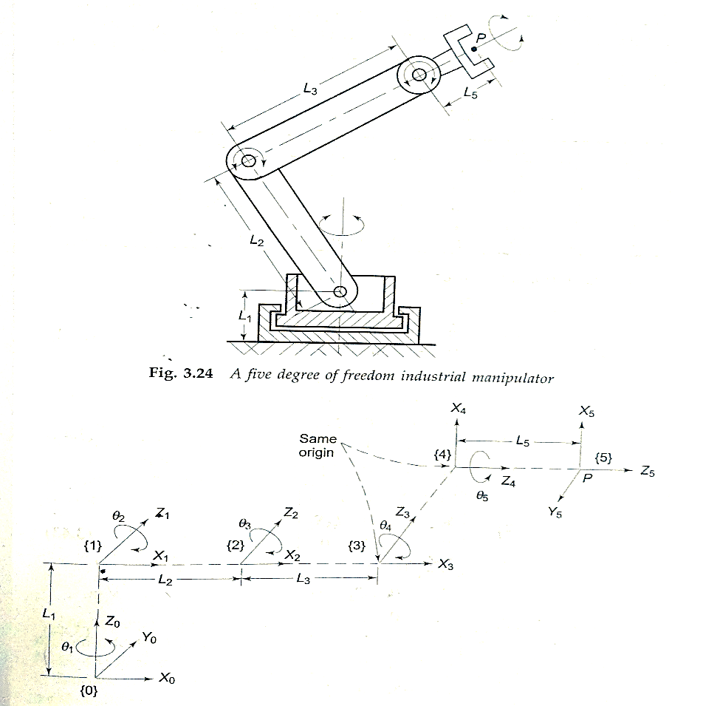
5 dof Articulated manipulator
Problem No. 7
All the five axes of the manipulator are revolute as shown in figure. Find the position and orientation of the end effector if the joint variable vector is q = [π/4 3π/4 -π/2 -π/4 π] ^{T} and the link parameters are L₁ = 50, L₂=L₃= 140 and L₅ = 20.

Slide 20
HOME WORK and Additional Exercises

Slide 21
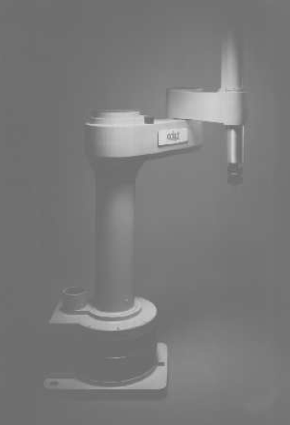
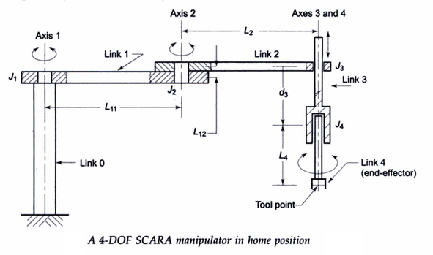
Home Work – 4 dof SCARA Robot
Problem 8
theta1 = 34.7473
theta2 = -60
theta4 = 0
L0 = 450
L11 = 400
L12 = 50
L2 = 300
L4 = 200
d3 = 100

Slide 22
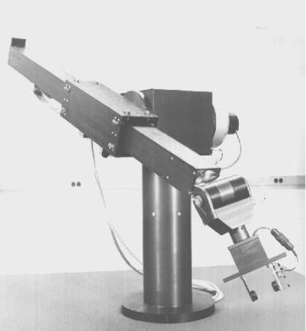
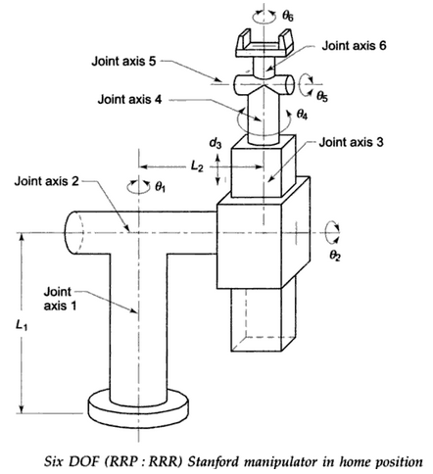
Additional Exercises

Slide 23
Take L1= 150 mm
L2 = 150 mm
d3 = 250 mm
L4 = 50 mm
L5 = 100
Theta1= 20
Theta2 = 35
Theta4 = 40
Theta5 = 30
Theta6 = 30

